Slide 1
Disease Specific Care Management: Congestive Heart Failure

Slide 2
Objectives
Define Congestive Heart Failure
Identify the different types of heart failure
Review medication used in heart failure
Become familiar with labs and imaging used to diagnose and manage heart failure
Discuss dietary and lifestyle changes that help manage heart failure
Identify Care Management strategies to help decrease ER visits and hospitalizations

Slide 3
What is Congestive Heart Failure (CHF)?
Complex clinical syndrome
Results from functional or structural cardiac disorders
Weakened heart muscles
Impaired ventricular ability to fill with or eject blood
Heart cannot pump enough blood to meet the body’s demand for blood and oxygen

Slide 4
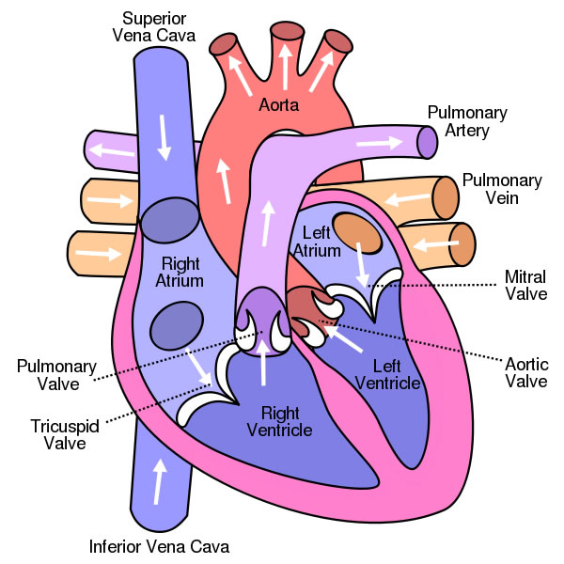
Different Types of Heart Failure
Systolic vs. Diastolic
Left-sided vs. Right-sided
Acute vs. Chronic

Slide 5
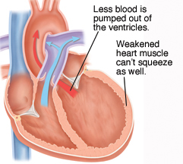
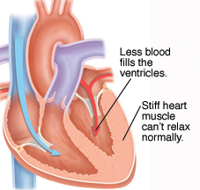
Systolic vs. Diastolic Heart Failure
Systolic:
inability of the heart to contract effectively
Approximately 2/3 of HF
LVEF < 40%
Diastolic:
Heart Failure with preserved ejection fraction (HFpEF)
Impaired filling/relaxation of the heart
LVEF >40%

Slide 6
Causes of Systolic Dysfunction
Coronary Artery Disease
Ischemic heart disease
Hypertension
Valvular heart disease
Aortic stenosis
Mitral valve stenosis
Arrhythmia
Dilated cardiomyopathies
Alcoholic
Idiopathic
Familial
Infectious
Diabetes

Slide 7
Causes of Diastolic Dysfunction
Hypertension
Ischemic heart disease
Hypertrophic cardiomyopathy
Restrictive cardiomyopathy
Inherited
Scar tissue
amyloidosis

Slide 8
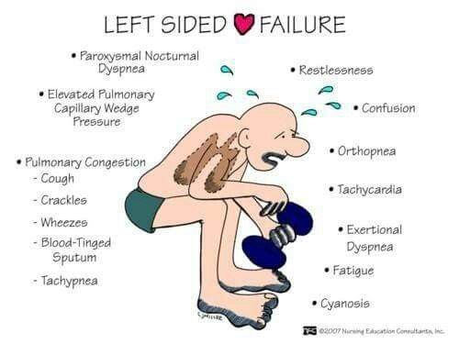
Left-sided Heart Failure
Left ventricular failure
Cannot effectively pump blood out
Fluid back up → Pulmonary interstitial edema
Impaired gas exchange

Slide 9
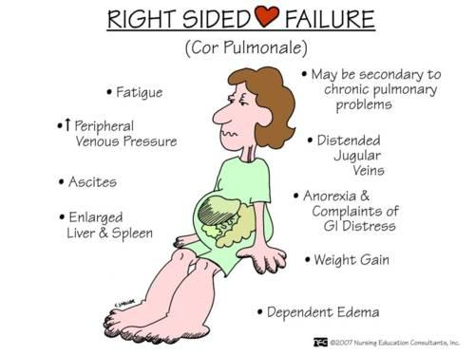
Right-Sided Heart Failure
Right ventricular failure
Causes congestion in peripheral tissue (edema)
Increased venous pressure → JVD

Slide 10
Acute vs. Chronic Heart Failure
Acute
Chronic
Develops suddenly
Symptoms initially severe
May follow heart attack
Can result from decompensation of chronic heart failure
Flash pulmonary edema
Usually requires IV meds
Often improves rapidly
Symptoms appear slowly
Gradually worsens over time
Periodic acute exacerbations
Approximately 50% of patients die within 5-years of diagnosis

Slide 11
Incidence and Impact of CHF
Affect almost 6 million adults in the US
Heart failure costs the US > $30 billion dollars annually
>11% ACO beneficiaries have CHF
>32% ACO admissions are for CHF
CHF makes up >23% of total ACO annual costs
ACO 30-day readmission rate is 9% overall but 12% for CHF
Preventing just one ER visit, admission or readmission has tremendous impact toward total savings!!!

Slide 12
Classification of HF
Stage A: patients at high risk for developing LV dysfunction but without structural failure (pre-heart failure)
Stage B: patient with LV dysfunction without symptoms of heart failure (pre-heart failure)
Stage C: patients diagnosed with HF who have or had signs/symptoms of condition
Stage D: patients with refractory end-stage HF requiring specialized interventions.

Slide 13
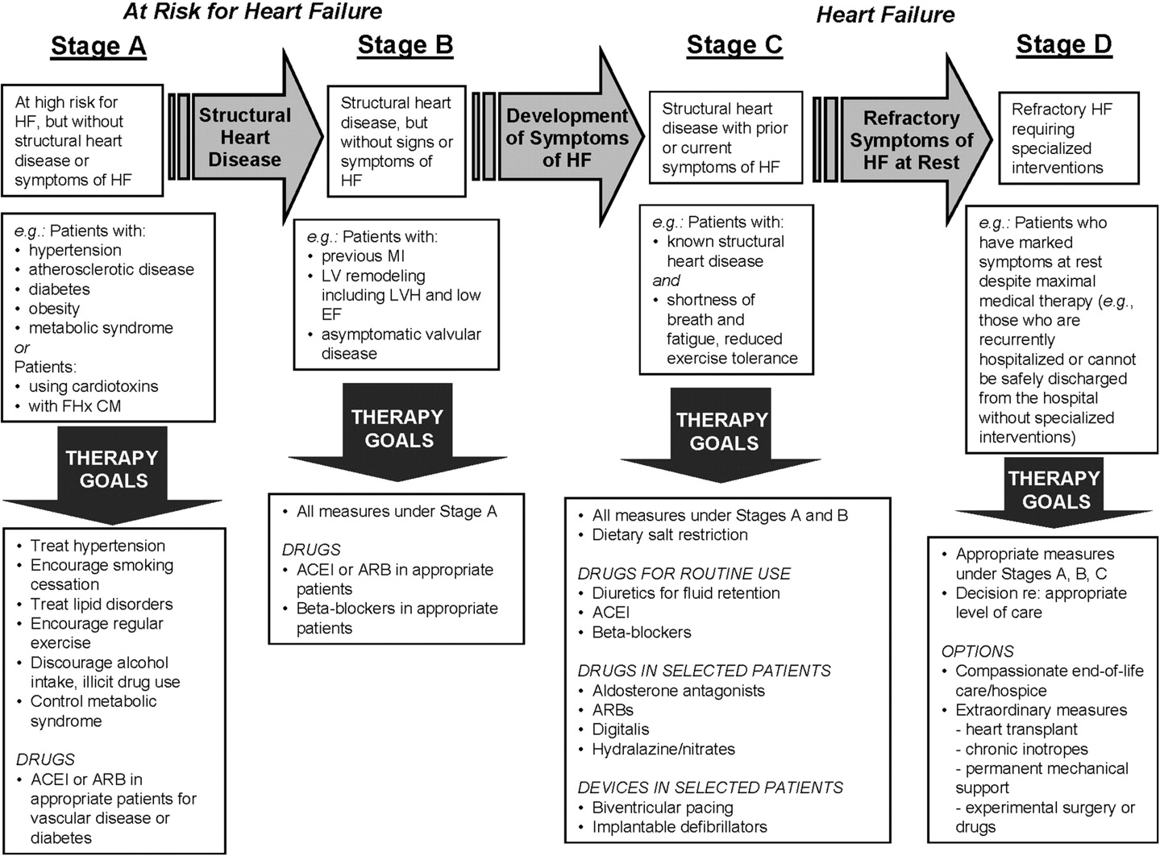
file://localhost/.file/id=6571367.22550232

Slide 14
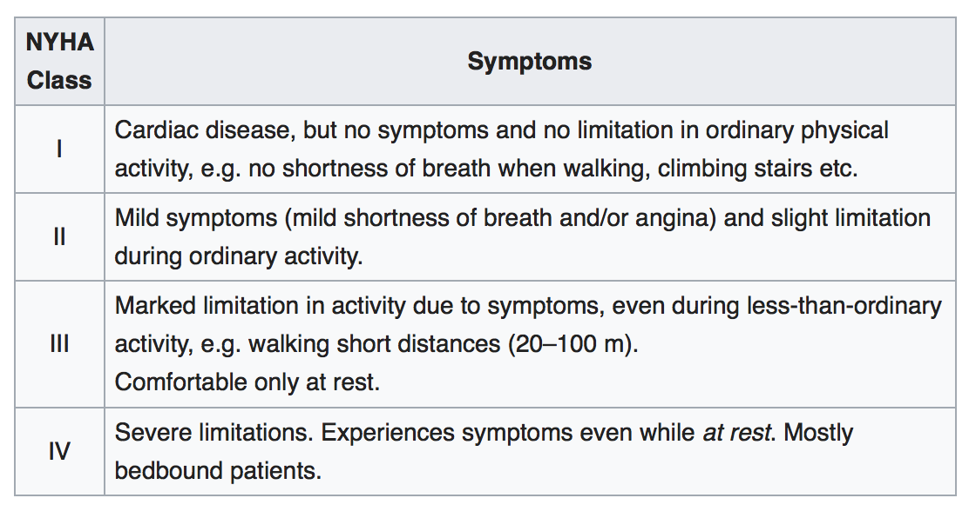
New York Heart Association (NYHA) Functional Classification

Slide 15
Medications and Heart Failure
Improve symptoms
Slow and reverse deteriorating heart function
Prolong survival
Improve functional status of patient
Classes of medication
Beta blockers
ACE Inhibitors
Angiotension II Receptor Blockers (ARBs)
Hydralazine and Nitrates
Aldosterone antagonists
Diuretics
Digoxin

Slide 16
Beta Blockers
Block the effect of stress hormones
Slow the heart rate
Allows more time for ventricles to fill
Improve cardiac output (CO=SV x HR)
Lower blood pressure
Who takes Beta Blockers?
symptomatic systolic failure (LVEF ≤ 40%)
Prior MI
Side effect
Dizziness
Bradycardia (slow heart rate)
Bronchospasm
Fatigue
Commonly used Beta Blockers
Carvediol (Coreg)
Bisoprolol (Zebeta)
Metoprolol Succinate (Toprol XL)

Slide 17
ACE Inhibitors (angiotensin converting enzyme inhibitors)
Block the enzyme the converts angiotensin I to II
Lower Blood Pressure
Block harmful neurohormones
Who takes ACE inhibitors?
EF ≤ 40% (with or without symptoms)
Coronary artery disease
Peripheral vascular disease
Prior stroke
Diabetes
Side effects
Dizziness
Cough
Angioedema
Elevated potassium
Renal insufficiency
Low blood pressure
Commonly used ACE inhibitors
Captopril (Capoten)
Enalapril (Vasotec)
Lisinopril (Prinivil, Zestril)
Quinapril (Accupril)

Slide 18
Angiotensin Receptor Blockers (ARBs)
Block angiotensin II
Lower blood pressure
Often second line to ACE inhibitors
Should not be taken with ACE inhibitors
Side effects similar to ACE inhibitors with less incidence of cough and angioedema
Commonly used ARBs
Losartan (Cozaar)
Valsartan (Diovan)
Irbesartan (Atacand)
Olmesartan (Benicar)
Telmisartan (Micardis)

Slide 19
Hydralazine/Nitrates
Vasodilators
Usually most effective in African Americans with NYHA III-IV who are already on ACE inhibitor and beta blocker
Contraindication
Concurrent used of phophodiesterase-5 inhibitors (Viagra, Cialis, Levitra)
Side effects
Headaches
Dizziness
hypotension
Drug induced lupus syndrome (hydralazine)
Commonly used vasodilators
Hydralazine
Isosorbide dinitrate (Isordil)

Slide 20
Aldosterone Antagonists
Potassium sparing diuretics that block aldosterone
Need to monitor electrolytes (potassium) and renal function
Indications
LVEF ≤ 30% & NYHA II (some symptoms)
LVEF < 35% & NYHA III-IV (moderate to severe)
LVEF ≤ 40% & post-MI, on therapeutic ACE inhibitors and symptomatic HF or DM
Side Effects
Hyperkalemia
Hirsutism
Gynecomastia
Contraindications
Potassium > 5
Serum creatinine > 2.5
GFR < 30
Common Aldosterone Antagonists
Spironolactone (Aldactone)
Eplerenone (Inspra)

Slide 21
Diuretics (“water pills”)
Used to improve symptoms if CHF
Shortness of breath
Edema
fatigue
Act on different sections of the kidneys to remove sodium and water
Reduce volume overload
Types of diuretics
Loop
Thiazides
Potassium-sparing

Slide 22
Diuretics (cont’d)
Monitor
electrolytes (K, Na, Mg)
Renal function
Daily weights
Side effects:
⬇ potassium, magnesium & calcium
Hyperuricemia
Dizziness
Hypotension
tinnitus
Precautions
Sulfa allergy
Gout
Loop diuretics
Furosemide (Lasix)
Torsemide (Demadex)
Bumetanide (Bumex)
Thiazide diuretics
Hydrochlorothiazide (Hydrodiuril)
Chlorothiazide (Diuril)
Chlorthalidone (Hygroton)
Indapamide (Lozol)
Metolazone (Zaroxolyn)
Potassium-sparing diuretics
Amiloride
Eplerenone (Inspra)
Spironolactone (Aldactone)
Triamterene (Dyrenium)

Slide 23
Digoxin
Improves pump filling
Improves heart failure symptoms
First line for HF with atrial fibrillation
Monitoring
Digoxin level: target 0.5-0.8 mcg/mL
Electrolytes (K, Mg, Ca)
Renal function
Who should take Digoxin
LVEF ≤ 40%
On standard HF therapy
With persistent symptoms
Side effects
Nausea/vomiting
Bradycardia
Visual disturbances
Diarrhea
Arrhythmias
Toxicity treatment
Symptomatic control
Digibind: antidote made of sheep antibodies
Cholestyramine or activated charcoal
Reduces hospitalizations
Does not improve morbidity/mortality

Slide 24
New Medications to Treat CHF
Entresto (valsartan/sacubitril)
Angiotensin receptor-neprilysin inhibitor (ARNI)
Shown to reduce hospitalizations
Do not give with or within 36 hours of the last dose of ACE inhibitor
Avoid in patients with history of angioedema
Corlanor (ivabradine)
Sinoatrial node modulator
Uses in patients with symptomatic, stable chronic HFrEF on beta blocker, in sinus rhythm with HR ≥ 70 at rest
Shown to reduce hospitalizations

Slide 25
Medications to Use with Caution
Anti-arrhythmics (quinidine, sotalol, ibutilide)
cardiodepressant
Calcium channel blockers
Non-dihydropyridines (verapamil, diltiazem)
Worsening heart failure
NSAIDs (ibuprofen, naproxen, diclofenac, meloxicam)
Sodium retention
Increase toxicity of diuretics and ACE inhibitors
Thiazolidinediones (TZDs) (pioglitazone, rosiglitazone)
Used in diabetes
Cause worsening heart failure

Slide 26
Labs and Imaging
CBC
Little diagnostic help
Aids in assessment of anemia which exacerbates HF
Consider evaluation for iron deficiency
Electrolytes: BMP & Mg
Affected by medications
May fluctuate with fluid status and diet
B-type natriuretic peptide
BNP or NT-proBNP
Used in acute setting to differentiate between ambiguous causes of SOB
<100 pg/ml HF unlikely, >500 pg/ml HF likely
Reference range depends on assay used, must know values for your lab
May be used to monitor progress after hospitalization
Renal function: BUN/creatinine
May worsen with over aggressive diuresis
Liver Function
Usually normal but may increase with liver congestion from fluid
Chest X-Ray
Cardiomegaly
Pleural effusions
Interstitial edema
Echocardiography
Preferred examination in CHF
Assesses systolic and diastolic LV function
Assesses cardiac output, ejection fraction
Identified valvular heart disease
Results difficult to interpret in patients with lung disease

Slide 27
Managing Heart Failure
Limit Salt
Helps avoid fluid build up
Low salt diet recommended, often limited to 2000mg daily
Most foods are prepared with salt
Avoid processed foods
Avoid fast food meals (including frozen dinners)
Avoid excess fluids
Water, soda, coffee, other beverages
Foods like soup that are mostly liquid
Patients may have fluid restriction
Monitor weight
Weight gain of 2-3 pounds in 1 day or 5 pounds in 1 week should be reported

Slide 28
Managing CHF (cont’d)
Maintain an active lifestyle
Mild to moderate activity
Walking program
Cardiac rehab may be an option
Avoid smoking/tobacco
Cigarettes, cigars, pipes
eCigs
Chewing tobacco
Abstain from alcohol
Avoid recreational drugs
⌘ Remember the Patient Centered Approach
⌘ Incorporate assessment of mood to guide care
⌘ Use motivational Interviewing techniques

Slide 29
Addressing Medication Side Effects
Dizziness upon waking
10 ankle pumps back and forth before standing up
Sit on edge of bed for 1 min before standing and rising
Wheezing
Might be from B-blocker
Underlying lung disease
Skipping diuretics
Assess mobility and need for aids (Urinal, commode)
Develop of plan for travel/appointment days
Cough
Fluid retention
ACE inhibitor
Underlying lung disease
Increased edema
Taking NSAID?
Review diet

Slide 30
Understanding Sodium

Slide 31
Other Sodium Claims
“Reduced sodium”
The product contains at least 25% less sodium per serving compared to the regular version
“Light in sodium” or “lightly salted”
The product contains 50% less sodium per serving compared to the regular version
“Unsalted,” “without added salt,” and “no salt added”
No salt was used in the processing of the product, when the product would normally be processed with salt (e.g. unsalted pretzels vs. regular pretzels)
Does not guarantee that the food is “sodium-free”

Slide 32
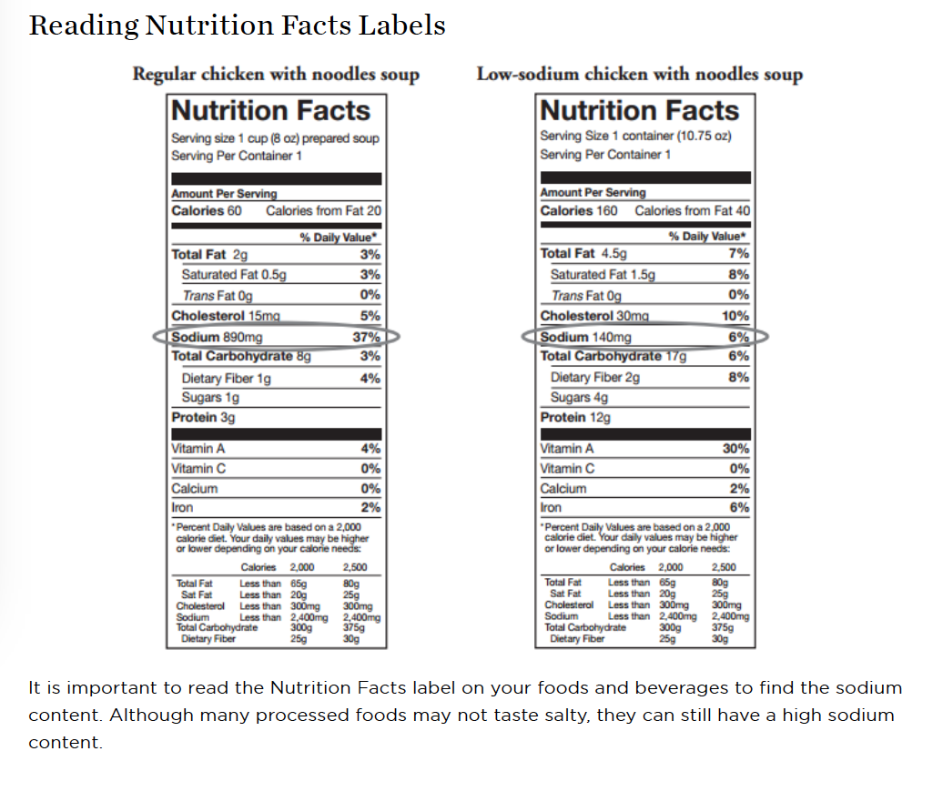

Slide 33
General Dietary Guidelines
Do not add salt to foods while you prepare them or at the table
Read the nutrition facts on your food and beverage labels
Cook more meals at home instead of dining out to better control the amount od sodium in your diet
In restaurants gravies, sauces, dressings and marinated foods are high in sodium. Order meals without these or with them on the side.
Dress your salad with oil and vinegar instead of prepared dressing
Choose unprocessed foods naturally low in sodium: fresh fruits and vegetables, whole grains (oats, barley, quinoa, brown rice) and legumes ( beans, peas, lentils).
Limit intake of milk, yogurt and ice-cream to 3 (8-ounce) servings daily as they are moderately high in sodium.
Only use salt substitutes approved recommended or approved by physician.

Slide 34
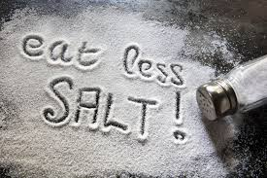
High Sodium Foods
Dairy
Buttermilk
Instant cocoa mixes
Cheese: American, blue cheese, feta, Provolone, Swiss, Edam, cottage
Meats & Fish
Smoked, cured, dried, canned or frozen processed meats
Deli Meats: corned beef, salami, ham, bologna, frankfurters, sausage, bacon, chipped beef, turkey
Starches & Bread
Breads, rolls and crackers with added salt
Cereal with >20% Daily Value sodium
Pizza
Salted chips and pretzels
Vegetable & Vegetable Juice
Canned or jarred vegetables and vegetable juice, tomato juice
Pickles, olives, sauerkraut
Canned and instant soup, bouillon
broth
Condiments
Bottle salad dressings, tartar sauce
Party spreads and dips
Canned gravies and sauces
Soy sauce, Worcestershire sauce, chili sauce
More than 1 tablespoon of ketchup
Onion salt, garlic salt, other seasonings containing salt
Cooking wine
Miscellaneous
Leavening agents: baking powder baking soda
Preservatives: sodium nitrate, phosphate and benzoate
Flavor enhancers (MSG)
Sweeteners (sodium saccharine)
Certain antacids.

Slide 35
https://millionhearts.hhs.gov/
http://www.heart.org/idc/groups/ahamah-public/@wcm/@sop/@smd/documents/downloadable/ucm_493382.pdf

