Slide 1
Outpatient Care Management at Claxton-Hepburn Medical Center
2019

Slide 2
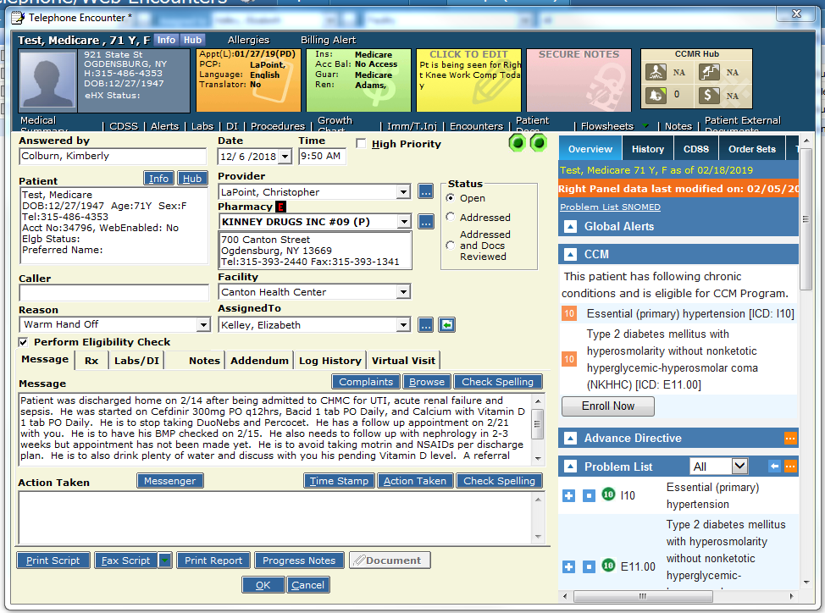
Warm Hand-Offs
CHMC case managers contact the outpatient Case Managers with Warm Hand-Offs (WHOs) upon patient discharge
Information includes: diagnoses, discharge date, change in medications, upcoming appointments, referrals, pertinent diagnostic testing, and any suggested further testing
Message is sent to PCP to make them aware of discharge and if there is anything they need to address upon discharge
If a referral to home health or Health Home was not discussed while patient was admitted, outpatient case managers contact patient to identify if one is needed

Slide 3
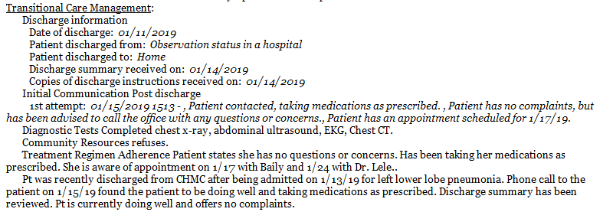
Transitional Care Management
“The management of (Medicare) patient’s transition from an inpatient to a community setting. Contact with the patient within 2 business days following discharge, and a face-to-face visit within either 7 or 14 calendar days of discharge depending on the complexity of the medical decision-making involved in the patient’s care.”
Non-face-to-face contact is included with a “WHO” or new encounter is created to make provider aware contact was made and to who case manager talked to
If having difficulty contacting patient within 2 business days, contact to CBOs is made to see if they have been in touch with patient since discharge
Identifying qualifying patients for TCM comes from ACO Patient Discharge Notification, HealtheConnections and CHMC internal daily reports
Providers and staff are attempting to make case managers aware when patients are admitted to outside facilities (such as CPH) so that monitoring can be completed to check on discharge status
Plans are currently in the works to reach out to area nursing homes and hospitals to collaborate with case management to identify when patients are discharged to complete TCM and schedule follow-up appointments

Slide 4
ER/Inpatient Discharge Review
Daily report is received via internal report to identify and schedule patients needing follow-up appointments.
Frequent ER visits and admissions are reviewed for case management potential
If a patient is set up with a CBO, contact is made to CBO and patient to identify if anything can be changed or if any new services are need in the home
If a patient is not set up with a CBO, discussion as to if any services are needed in the home is completed

Slide 5
Reports
Reports are run on a weekly basis monitoring patients with more than 15 medications, reliable transportation, and A1c greater than 9.
If more than 15 medications, contact is made to identify if patient is able to afford medications, if they understand what medications are for, when to take them and any further education on medications that is needed
If transportation issues, contact is made to identify how patient gets to and from appointments, check insurance eligibility, and providing information for Medicaid Answering Service, Fidelis Transportation, and/or Volunteer Transportation Center
If A1c greater than 9, contact is made to identify if patient is able to afford medications and supplies, encourage referral to diabetes education, and further education on nutrition, exercise, and medications
Contact is often made over the phone, but able to meet with patient in the office if set up ahead of time. Referrals are placed to CBOs if patient expresses difficulty and is seeking help with management of any issue. Referrals are often placed to Northern Lights and HSNNY but occasionally referrals are made to Health Home if patient qualifies

Slide 6
ACO Reports
ACO Roster
Identify patients who the office needs to be aware of
Patient Outreach
Schedule patient for appointment with MD and or mid-level as appropriate
If patient is chronic no-show, case management will attempt contact with patient to see if they need assistance getting to appointment
High Risk
Discuss with nurses and provider each patient and identify which CBOs are in place and/or identify what case management services patient may need including CCM and TCM

Slide 7
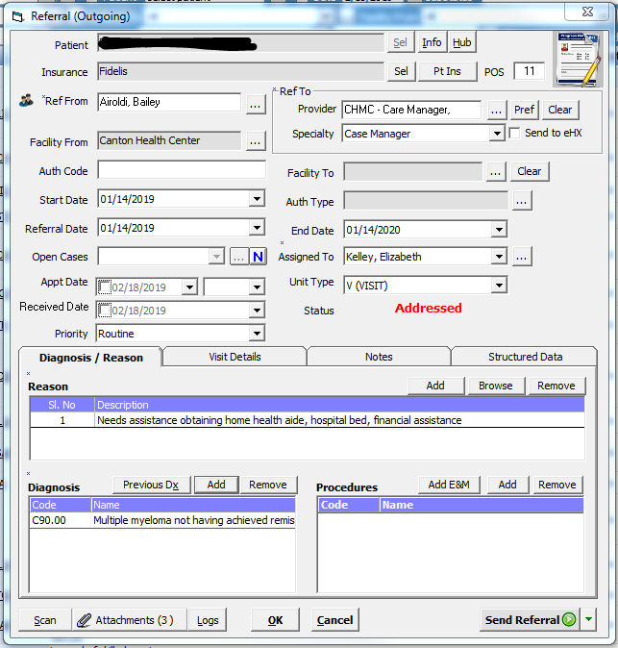
Referrals
During a telephone encounter with the patient or at an office visit, a referral can be sent over to case management to assist the patient with variety of needs
Referrals to CBOs are made to assist patient if attempts to assist over the phone are not successful or patient requests assistance in the home
Ability to meet with patient in the office can be scheduled ahead of time or contact is usually made over the phone

Slide 8
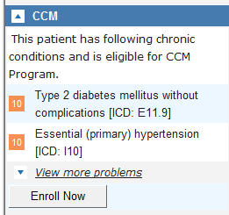
Chronic Care Management
Chronic care management (or CCM) is defined as services provided by a physician or non-physician practitioner and their clinical staff, per calendar month, for patients with multiple chronic conditions expected to last at least 12 months or until the death of the patient, and that place the patient at significant risk of death, acute exacerbation/decompensation, or functional decline.
CCM is person-centered and requires more centralized management of patient needs and coordination among practitioners and providers.
CMS considers CCM as a critical component of primary care that contributes to better health and care for individuals as the patients will receive a comprehensive care plan and 20 minutes a month or more for phone check-ins, and the ability to reach someone from their care team when they need to.
Referrals to CCM are often prompted by providers but case managers often suggest referrals while reviewing each patient chart for each report or referral if patient is in need of increased assistance.

Slide 9
Challenges
Lack of behavioral health support
Patients needing behavioral health support are often turned away from CBOs or quickly discharged
Frequent calls between case managers and/or office with patient and/or family
Lack of communication between CBOs that will work with patients and office in regards to status of documents or patient status
Difficulty contacting CBOs and Insurance Case Managers
Multiple calls made to CBOs and Insurance Case Managers with no calls back
Often have to find different points of contact to reach a supervisor to get to person working with patient
Lack of communication between CBOs and Primary Care
Unless patient is working with AIM, Hospice, or home health agency often times office is not aware if anyone is working with the patient unless we made referral
HealtheConnections has limited data from outside facilities, especially PCPs so identifying patients needing follow-ups is often difficult when reviewing daily listing
Ability to break down listing by provider but that only provides data from facilities that submit PCP data

Slide 10
Success
48 year old female diagnosed with adenocarcinoma stage IV. Lived on second floor of apartment with no elevator. Had difficulty obtaining transportation, obtaining DMEs, no local family support, unable to grocery shop, lack of communication with CBOs
Patient often was unable to leave her house and often ran out of food until she contacted her 80+ year old mother who would drive an hour to bring patient groceries and/or bring patient grocery shopping but both had difficulty with oxygen tank.
Referral to case management was made when PCP identified patient needed more assistance
Worked with patient for 10 months before she passed away
Often made the comment she felt as though she was giving up by accepting help and was dying if she accepted any help or DME near the end she realized she needed the help and gladly accepted any help she could obtain and reached out as soon as she identified something else was needed or she had an issue
Assisted patient with obtaining meals, light weight portable oxygen, referral for home health agency, referral to AIM, obtained hospital bed as she was sleeping on her couch, obtained wheelchair, assisted with transportation needs, and assisted family with finding housing closer to her mother and sister who lived an hour away
Unable to obtain meals on wheels due to age and patient did not like to admit she needed help. Had difficulty obtaining PCA care for patient due to inability to find agency willing to assist or have staffing and patient refusing skilled help. After 5 months of working with patient, she agreed to skilled nursing, PT and home health aid and was able to obtain MOM’s meals with having aid in the home

