Slide 1
A Federally Qualified Health Center
WWW.CHCNORTHCOUNTRY.ORG

Slide 2
Our Mission
Our mission is to provide comprehensive, accessible health and human services in the counties of Northern New York with a special commitment to low income, medically underserved individuals, & people with disabilities.

Slide 3
Health Centers
In New York State health centers deliver high-quality care to over 2 million people; that is about 1 in 9 residents. We help achieve better performance among traditionally underserved and at-risk patient populations. Across the country almost 30 million people now receive their care at a health center.

Slide 6
Health Centers
Increase Accessibility to Care
Provide Integrated Services
Lower Health Care Costs for Patients and the Community As A Whole
Reduce Disparities

Slide 7
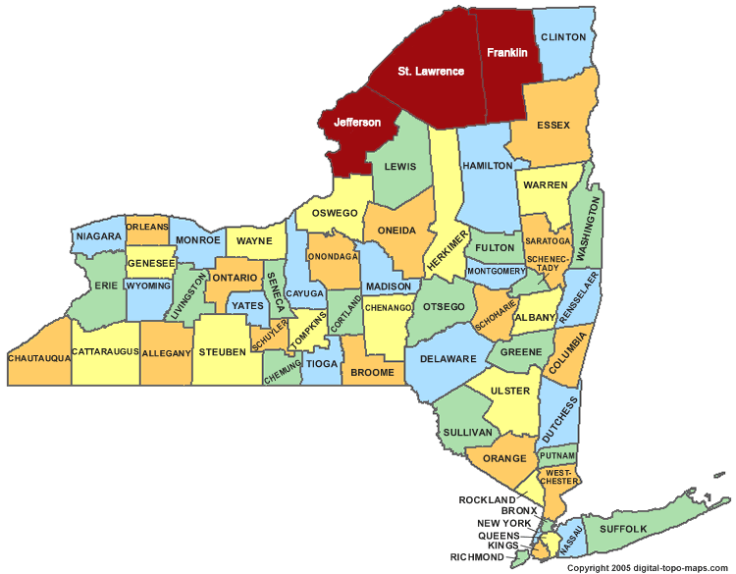
Service Areas
CHCNC serves St. Lawrence, Franklin
and Jefferson Counties

Slide 8
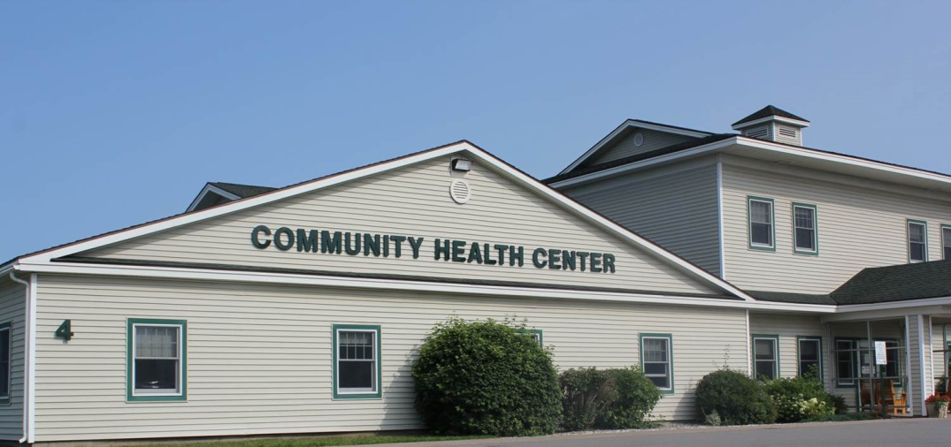
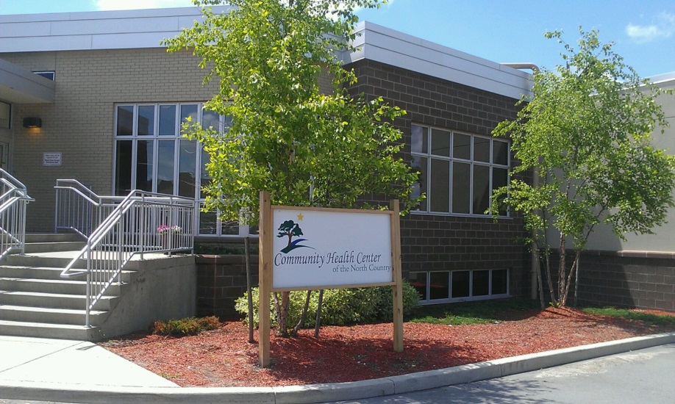
Site Locations
Canton
Gouverneur

Slide 9
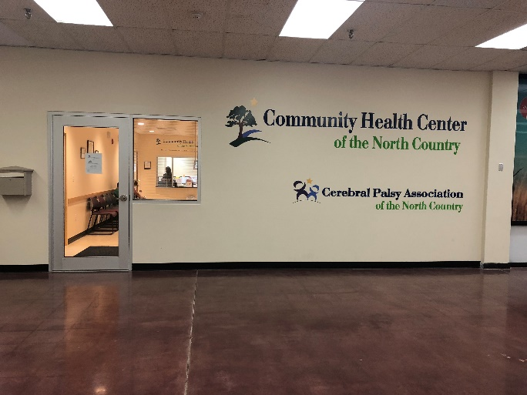
Site Locations
Malone
Watertown

Slide 10
OGDENSBURG

Slide 11
We offer the following Services:

Slide 12
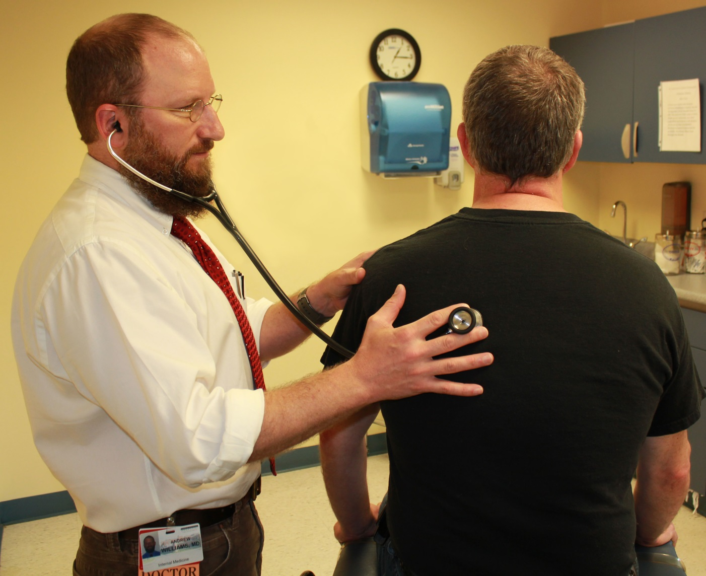
Primary Care

Slide 13
Primary Care
General Health Care
Breast, Cervical & Colorectal Cancer Screenings
Women’s Health
Diabetic Foot Care

Slide 14
Pediatric Care

Slide 15
Pediatric Care
General Check-ups
Immunizations
Referrals to Specialists

Slide 17
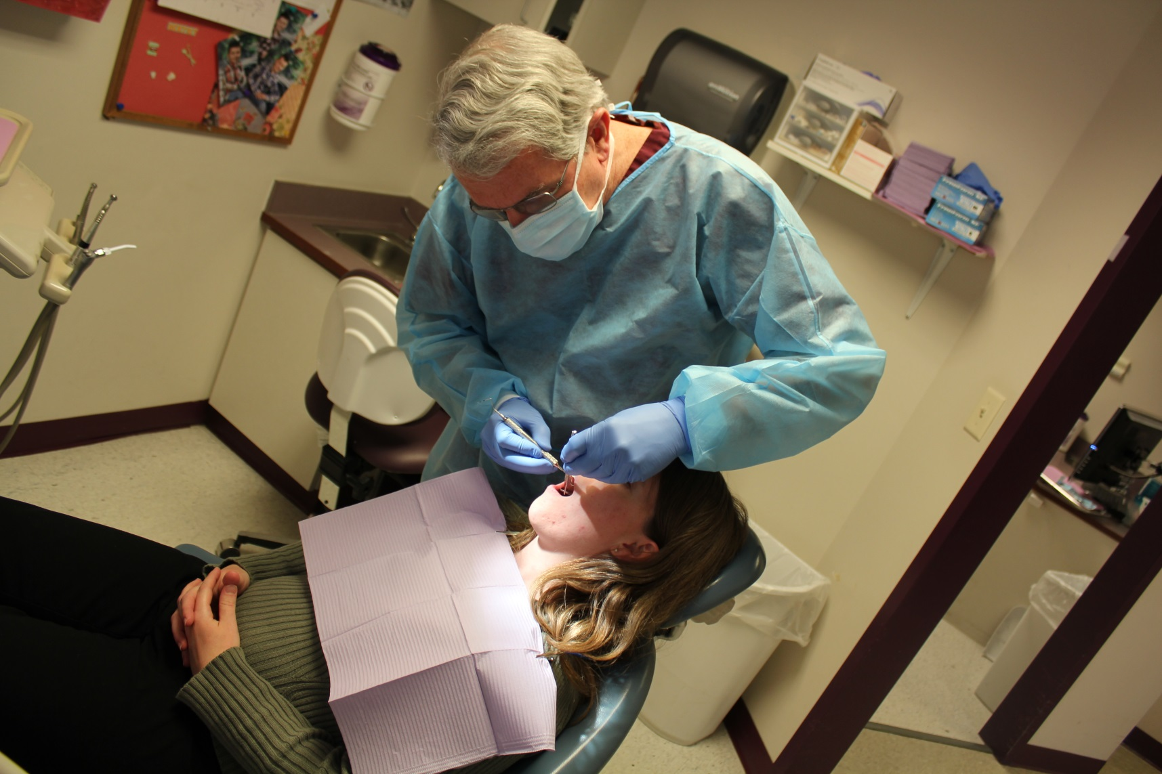
Dental Care

Slide 18
Dental Care
Routine Check-Ups & Cleanings
Fillings & Extractions
School Based Dental Sealant Program
Oral Cancer Screenings

Slide 19
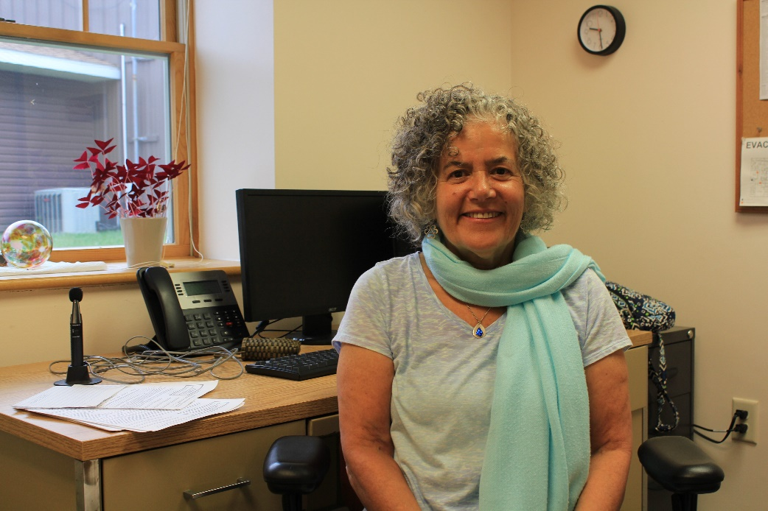
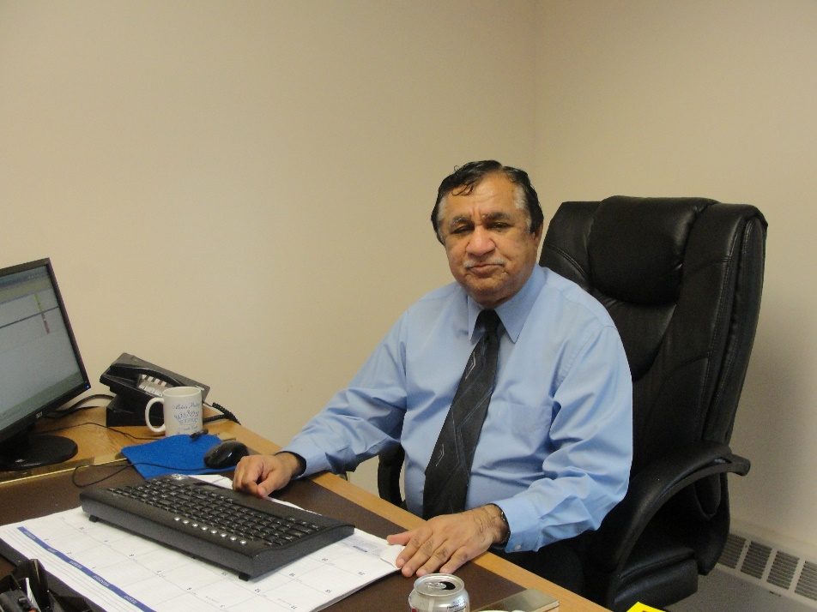
Behavioral Health

Slide 20
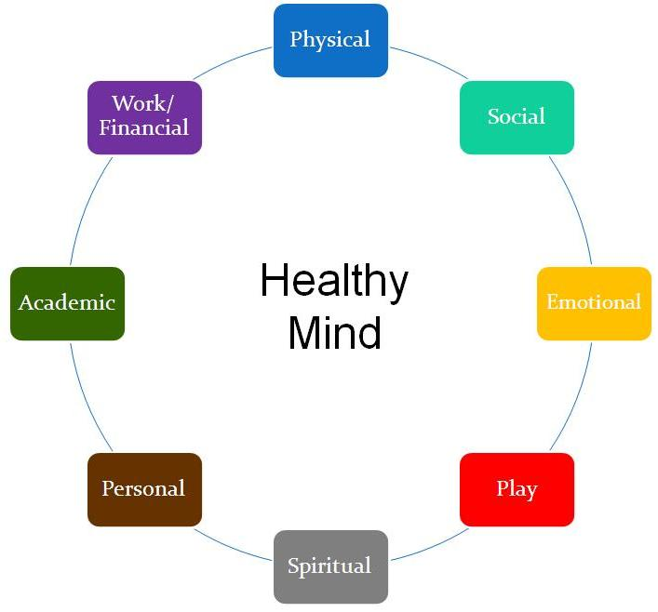
Behavioral Health

Slide 21
Behavioral Health
Screening Evaluations
Psychiatric Assessments
Ongoing Psychiatric Reviews with Medication Therapy
Individual Therapy with LCSW-R
Supportive Education

Slide 22
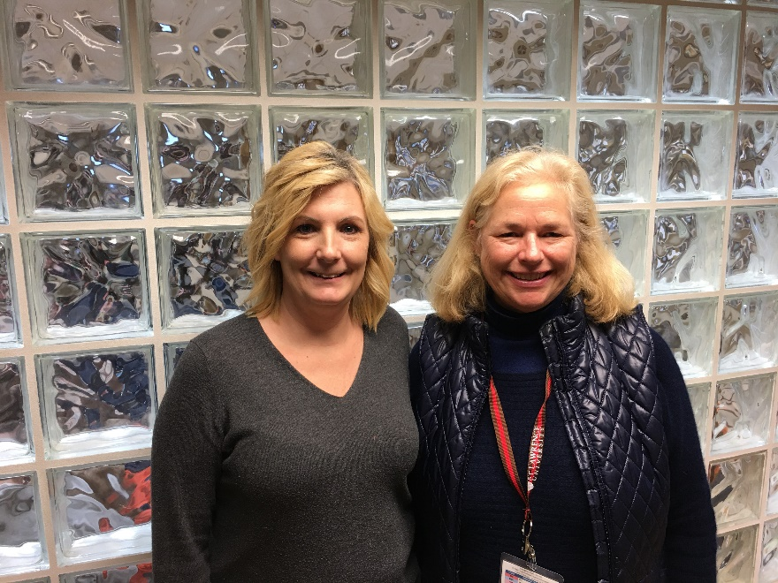
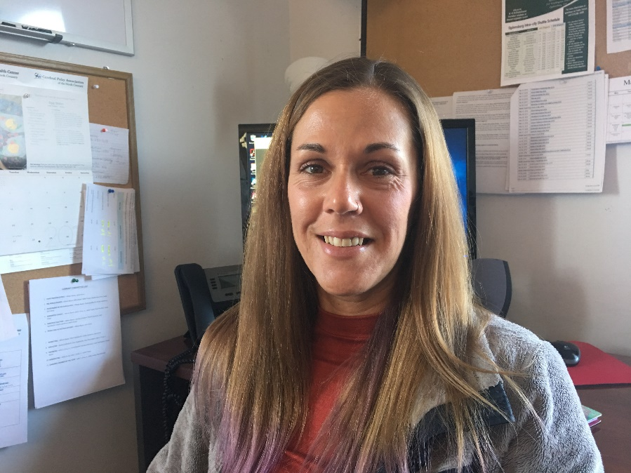
Care coordination

Slide 23
Care coordination
Transportation
Substance Use Disorder
Chronic Care Management
Outreach and Enrollment

Slide 24
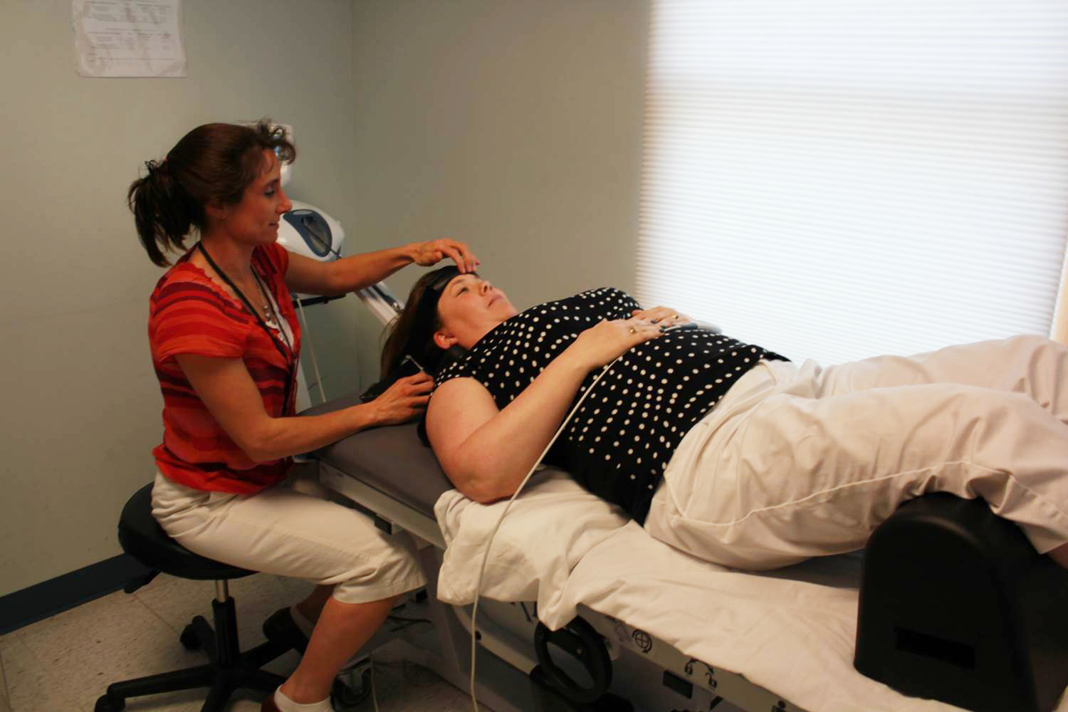
Physical Therapy

Slide 25
Physical Therapy
Treatment for adults & children with orthopedic conditions, neurological disorders, & chronic pain.
Short-term rehabilitation
Long-term maintenance PT for patients with diagnosis of developmental disabilities
Evaluations for assistive devices

Slide 26
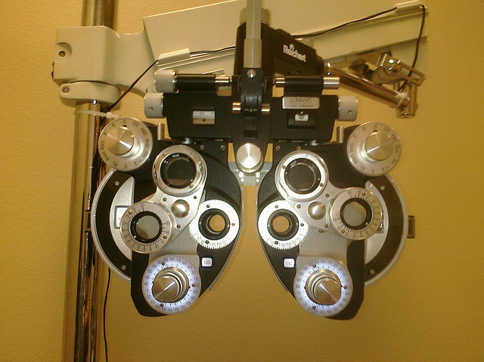
Optometry

Slide 27
Optometry
Complete Eye Exams
Glaucoma Testing
Prescription Filling for Medicaid participants
Optician Services

Slide 28
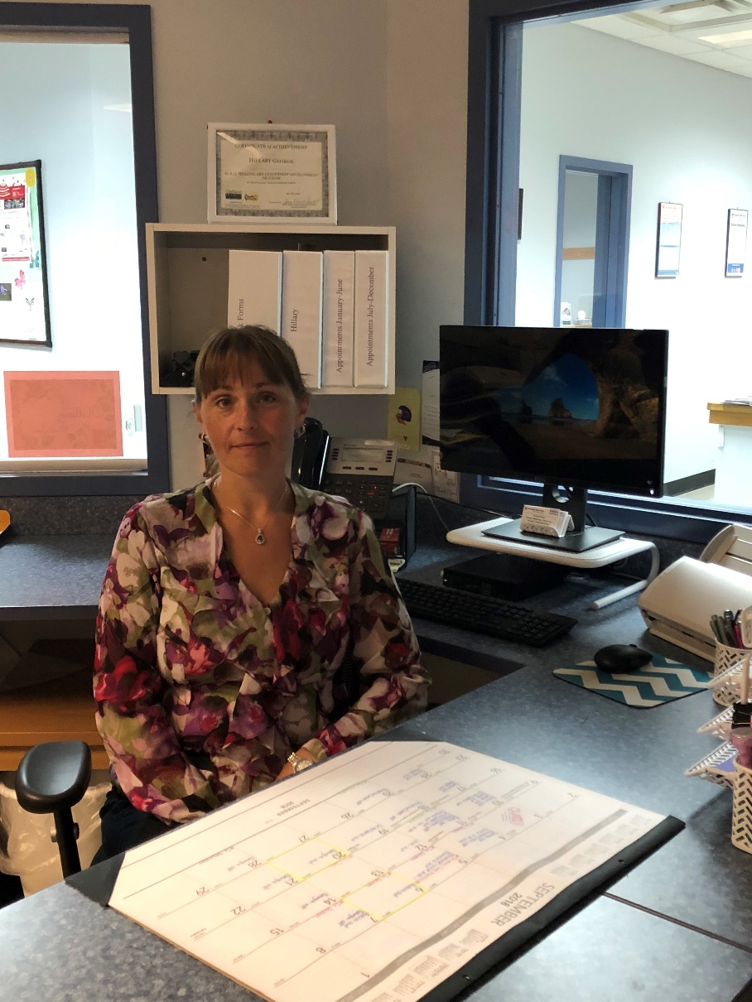
Case Management

Slide 29
Case Management
Arranges patient transportation
Links patients to medical & social services inside and outside the agency
Assists the uninsured and under-insured in obtaining affordable medications
A liaison for patients with social service agencies
Assists patients confronted with homelessness, home heating, domestic violence, mental health and food insufficiency issues.

Slide 30
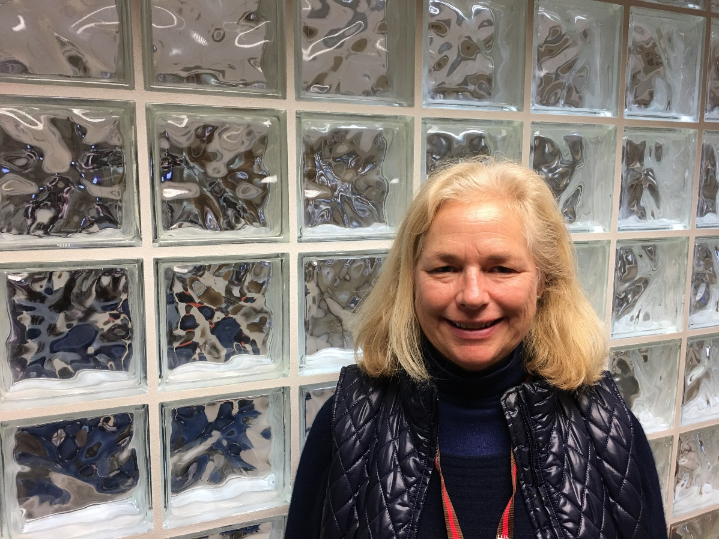
Health Insurance
Enrollment

Slide 31
Health Insurance
Enrollment
Our health center staffs a full-time Outreach and Enrollment Coordinator
If you have questions about health insurance and NYS Marketplace enrollment, we are available to assist you.

Slide 32
Consumer Directed Personal Assistance Program
Your Life, Your Home, Your Care

Slide 33
Consumer Directed Personal Assistance Program
Your Life, Your Home, Your Care
The CDPAP program is designed to lower costs on the healthcare system while allowing people to remain in their own home.
Any resident of St. Lawrence, Franklin, or Jefferson counties who is eligible for Medicaid and who currently receives or is able to receive personal care assistance can apply.
Contact Donna Elliot, Director of CDPAP, at
315-386-1156 for more information.

Slide 34
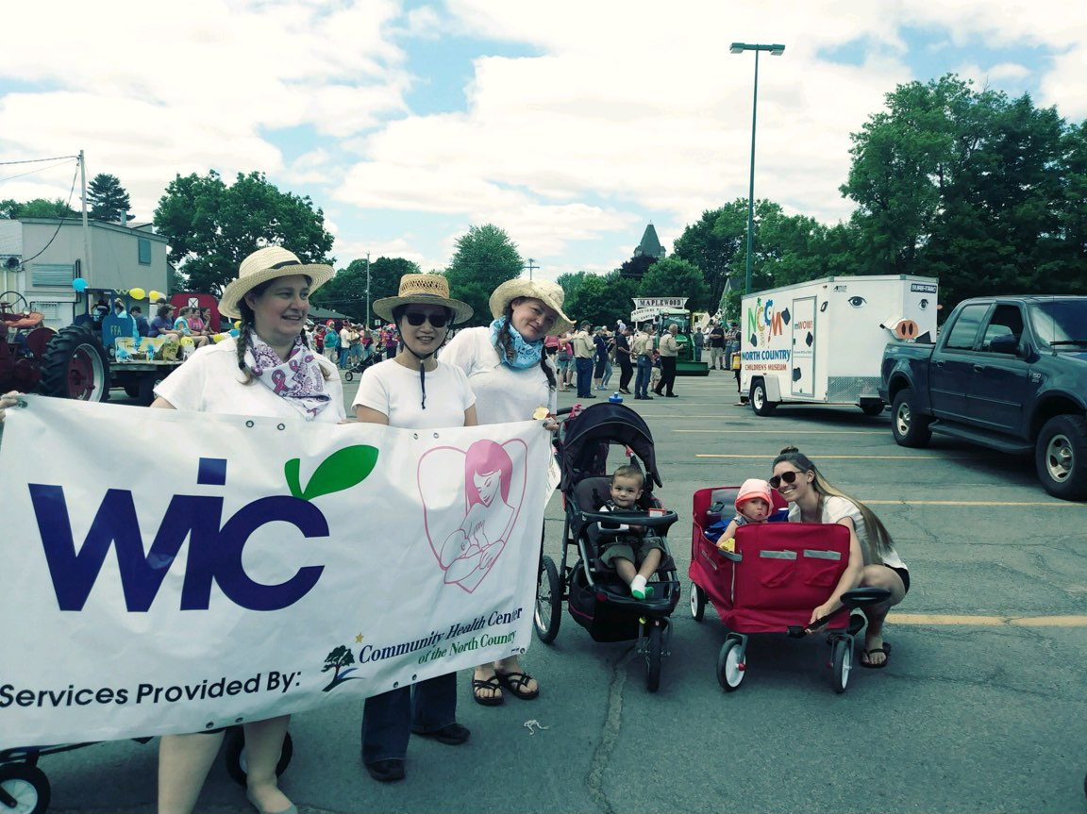
WIC Services

Slide 35
WIC Services
Community Health Center of the North Country administers the WIC program in Franklin and St. Lawrence
counties.
Approximately 2,500 clients in both counties.
Healthy Communities Start with Proper Nutrition…..Be WIC Strong.
Find out more at wicstrong.com

Slide 36
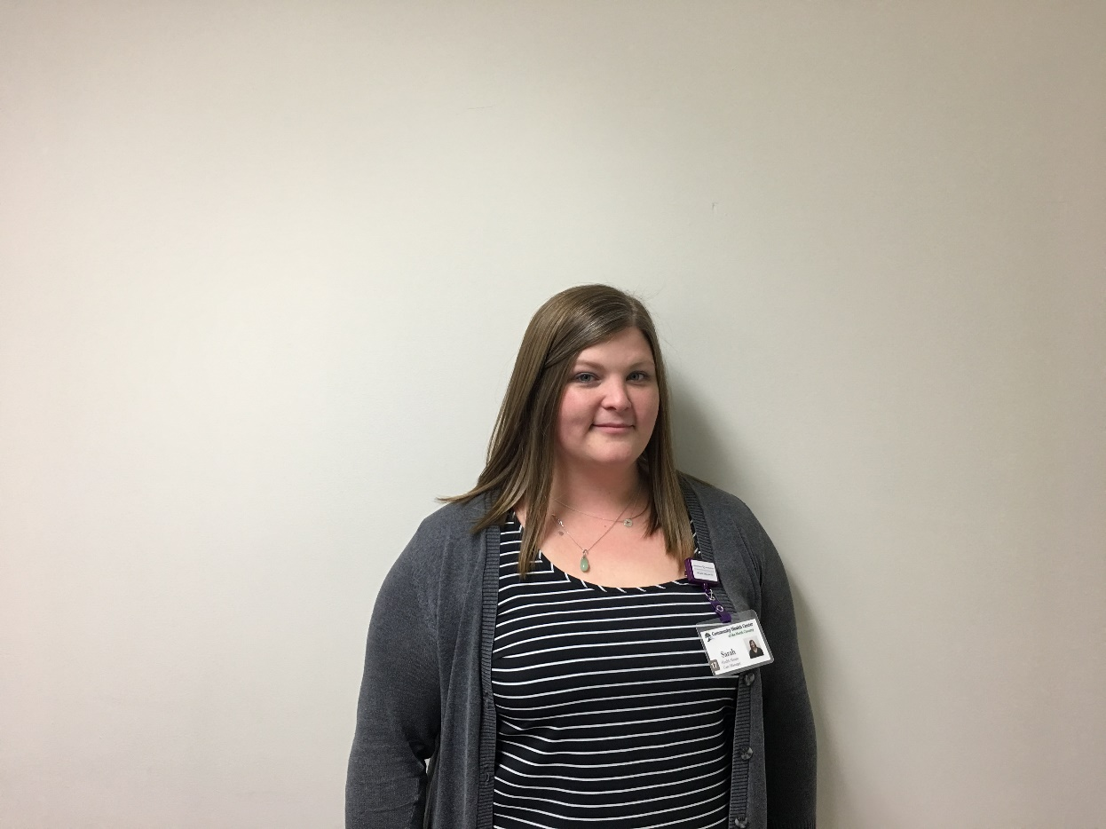
HEALTH HOME

Slide 37
HEALTH HOME
A Health Home is not a physical place, more so a group of healthcare and service providers working together to coordinate access to care.
To be eligible one must be enrolled in Medicaid, and have 2 or more chronic conditions, 1 single qualifying chronic condition such as HIV/AIDS, Serious Emotional Disturbances (SED), or Complex Trauma.

Slide 38
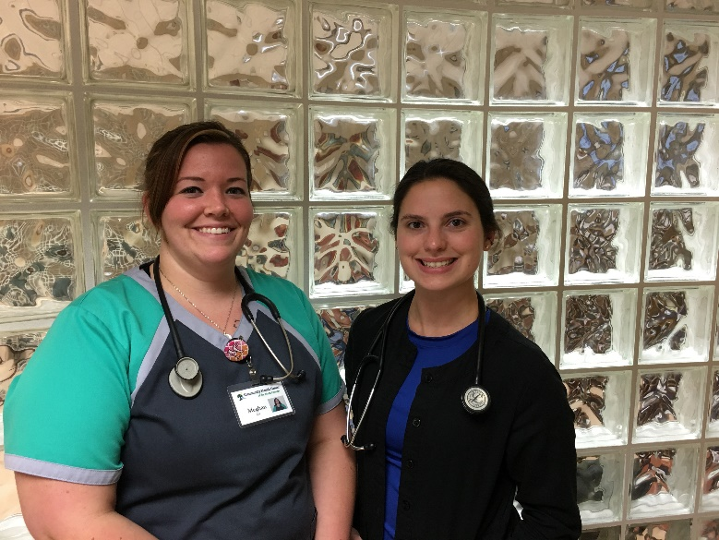
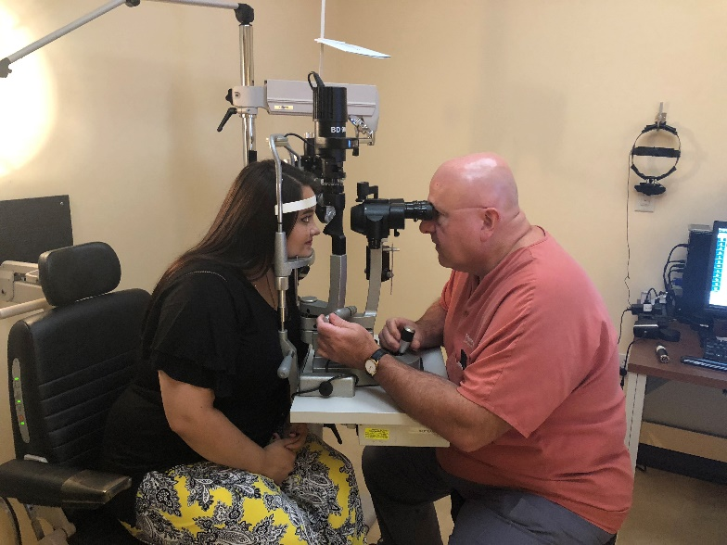
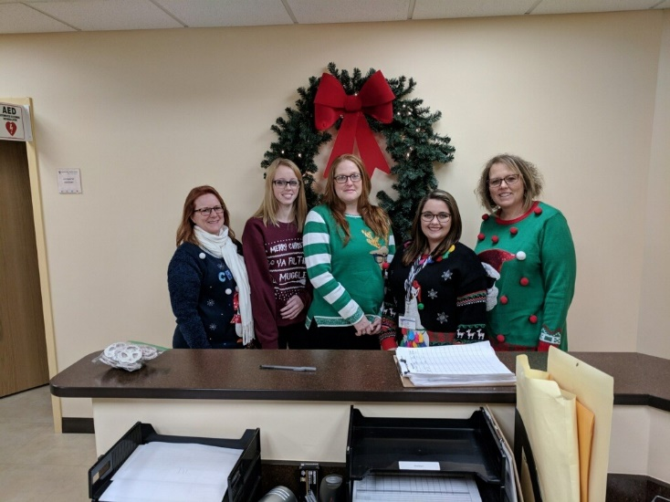
The Next Generation of
Health Care is Already Here

Slide 39
A Federally Qualified Health Center
WWW.CHCNORTHCOUNTRY.ORG

